Slide 1
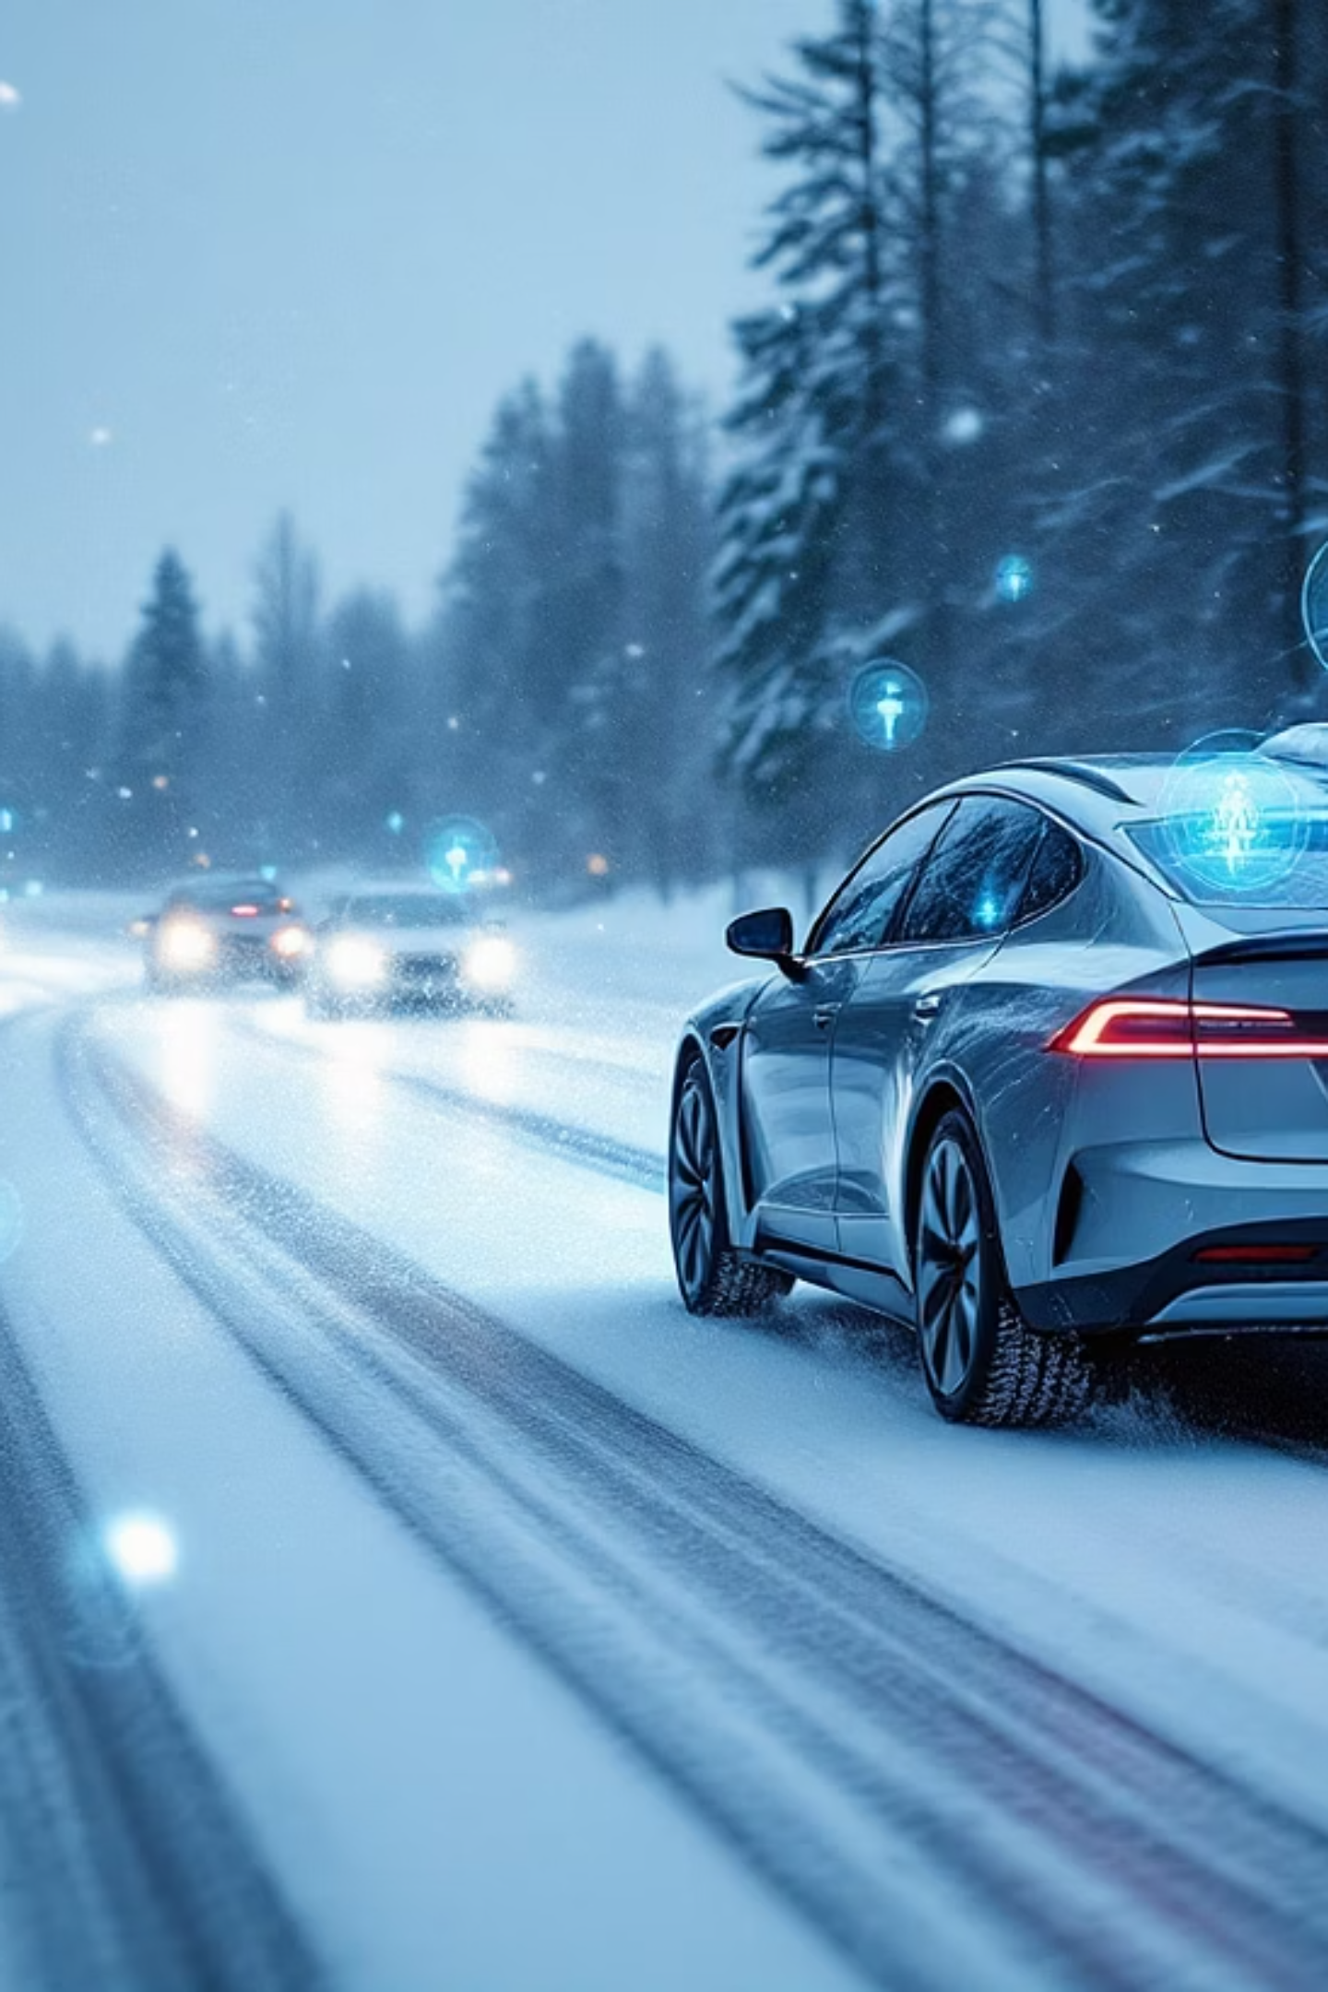
3D Object Detection with CADC Dataset
Advancing autonomous vehicle perception through robust object detection in adverse driving conditions using the Canadian Adverse Driving Conditions Dataset

Slide 2
Problem Statement & Motivation
Autonomous Driving Challenge
CADC Dataset Advantage
Research Objectives
First large-scale dataset specifically designed for adverse driving conditions, providing essential training data for robust perception systems.
Develop and evaluate object detection models capable of maintaining performance across varying weather, lighting, and road conditions.
Current perception systems struggle with adverse weather conditions, limiting real-world deployment of autonomous vehicles in challenging environments like Canadian winters.

Slide 3
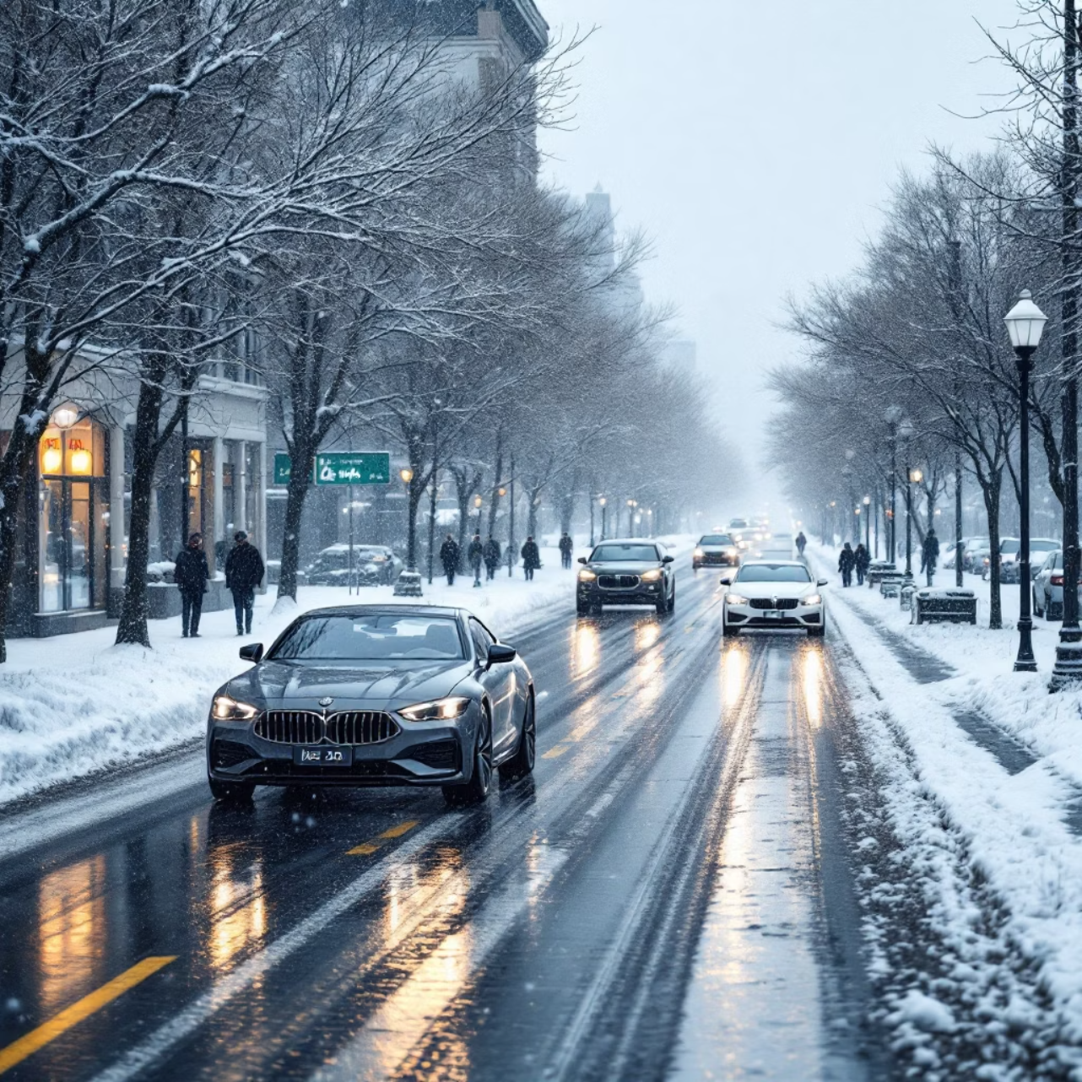
CADC Dataset Overview
Dataset Composition
56,000+ camera images with 3D annotations
Calibrated stereo camera setup with LIDAR
Seven object classes: car, truck, bus, bicycle, motorcycle, pedestrian, traffic light
Diverse conditions: snow, fog, rain, night driving
Technical Specifications
Intrinsic/extrinsic calibration matrices in YAML format
3D bounding boxes with world coordinates
Synchronized multi-modal sensor data

Slide 4



Data Preprocessing Pipeline
Dataset Parsing
Custom PyTorch Dataset class loads images and parses YAML calibration files to extract camera intrinsics and extrinsics for 3D-to-2D projection.
Annotation Processing
3D bounding boxes transformed to 2D image coordinates using camera projection matrices, with visibility checks and occlusion handling.
Data Augmentation
Standard torchvision transforms applied including normalization, random horizontal flips, and color jittering to improve model generalization.

Slide 5
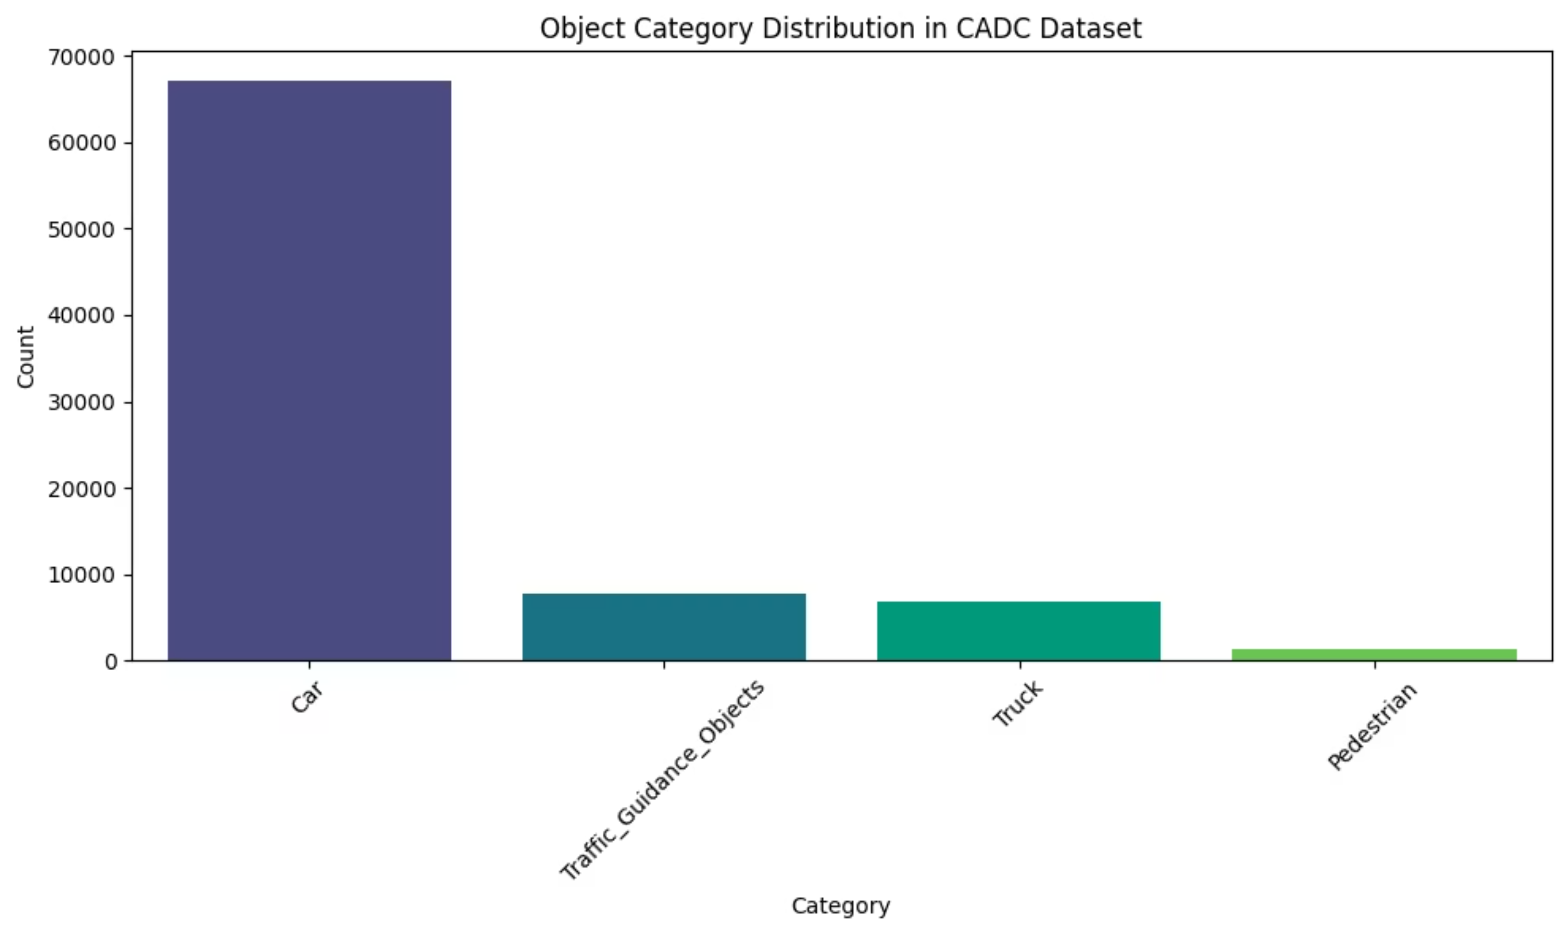

Slide 6
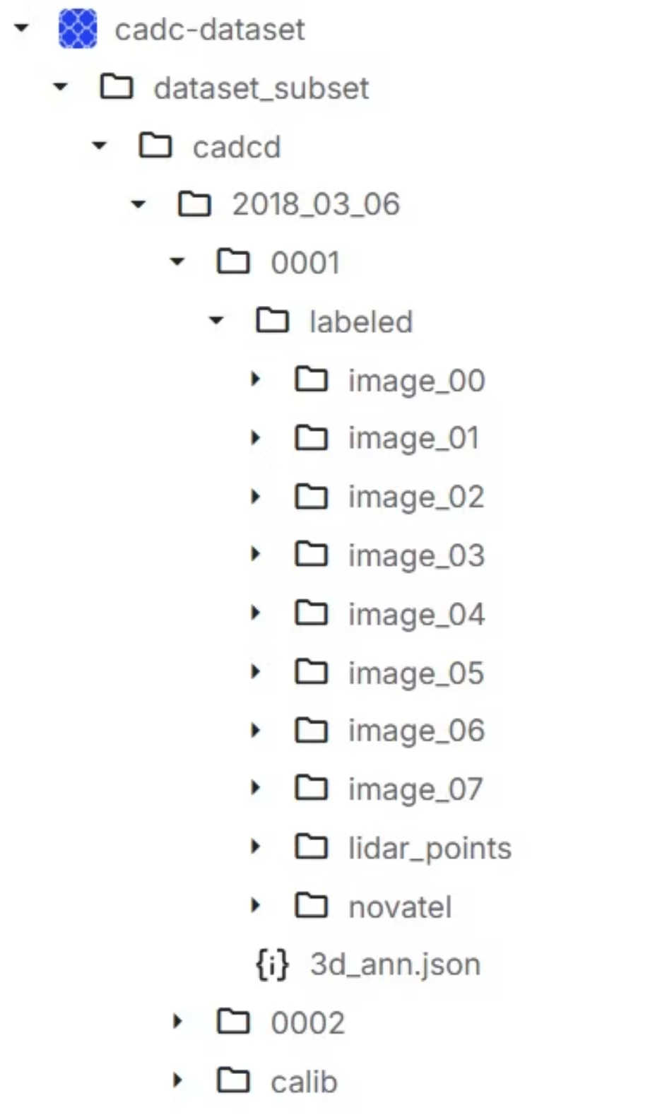
Dataset File Directory Structure
CADC Organization
The dataset follows a hierarchical structure with separate directories for different data modalities and annotation formats.
cadcd/ - Root directory containing all dataset files
raw_data/ - Original sensor recordings organized by date
annotations/ - 3D bounding box labels in YAML format
calib/ - Camera calibration parameters and transformations
processed/ - Preprocessed training and validation splits
This organized structure enables efficient data loading and ensures reproducible model training across different experimental configurations.

Slide 7
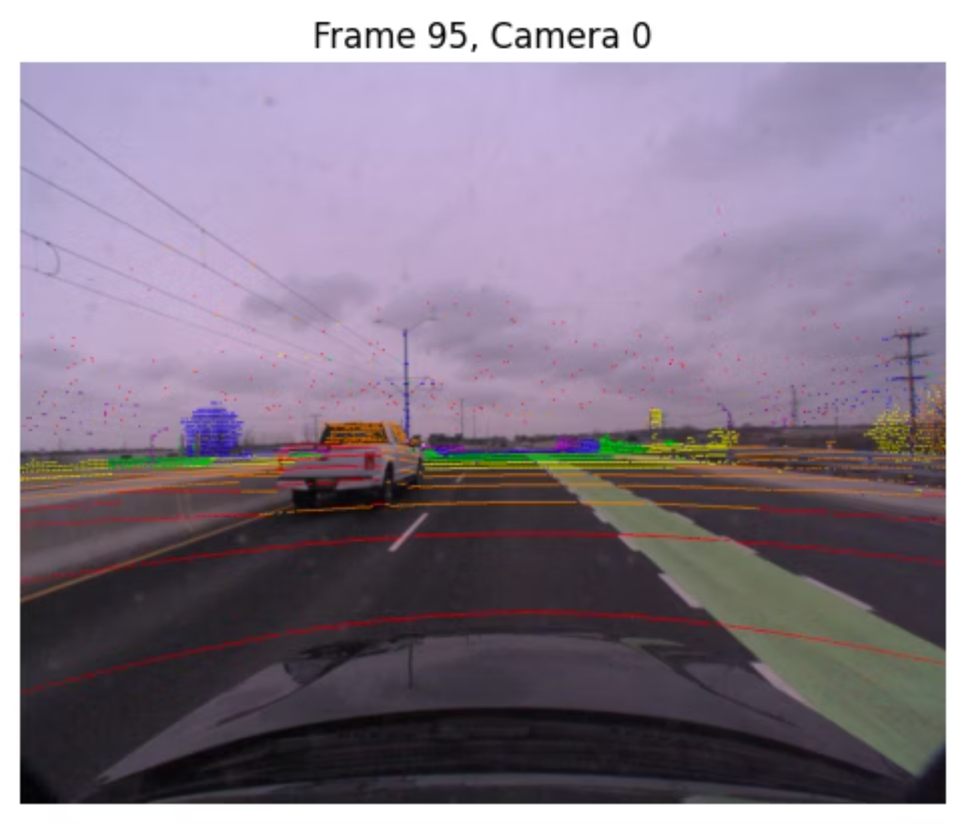
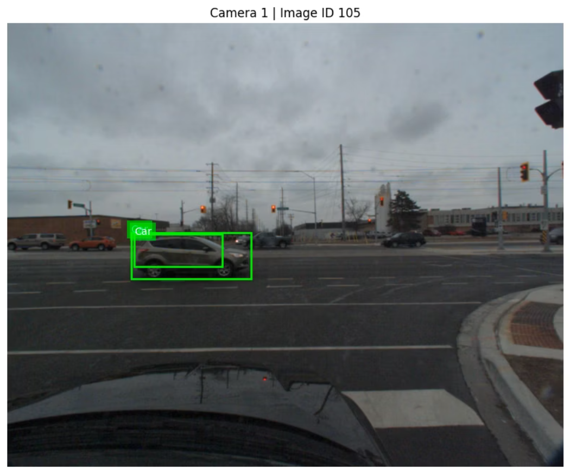
Training Dataset Sample
LIDAR Point Cloud
Camera Image with Annotations
3D point cloud data captured by the LIDAR sensor, providing spatial depth information for accurate object localization in adverse weather conditions.
Synchronized camera image with projected 3D bounding boxes, demonstrating the multi-modal nature of the CADC dataset and ground truth annotations used for training.
The integration of LIDAR and camera data enables robust object detection by leveraging complementary sensor modalities - LIDAR provides precise distance measurements while cameras capture rich visual features and textures.

Slide 8
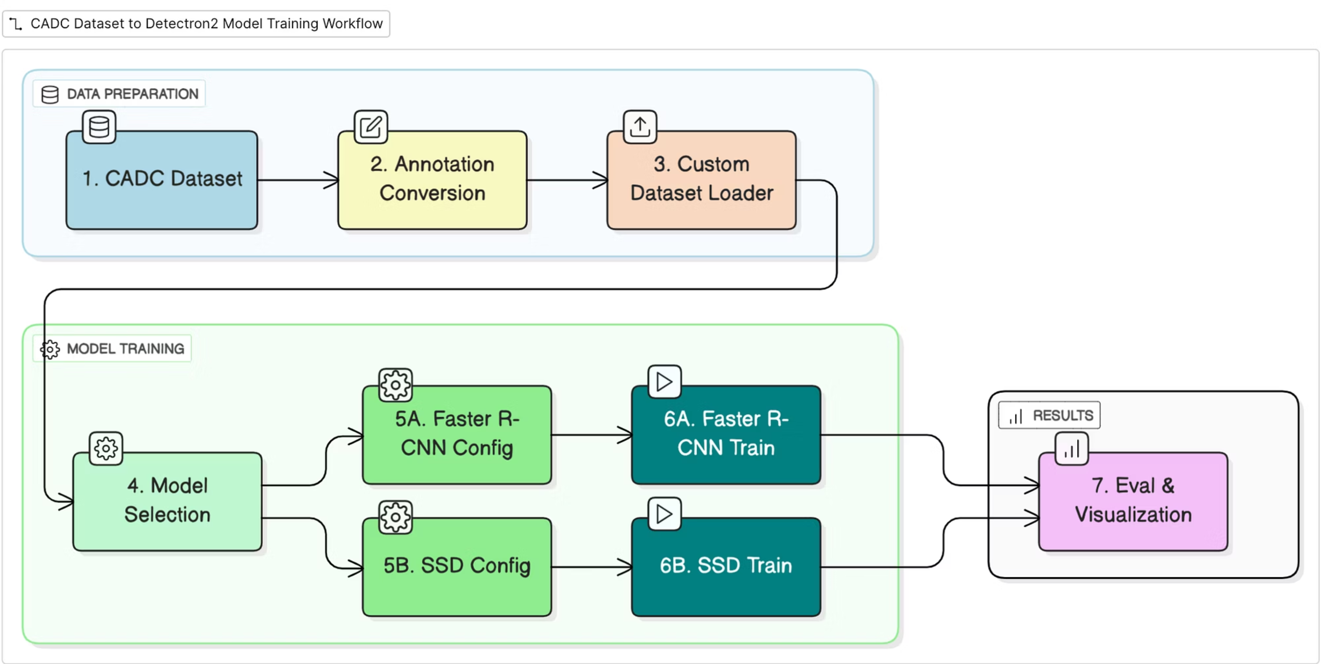
Overall Workflow

Slide 9
Model Architecture & Training
Faster R-CNN Implementation
Single‑Shot Detector (SSD) Implementation
Torchvision pre-trained backbone (ResNet-50)
Architecture: SSD with VGG‑based feature extractor + multi‑scale extra layers; combines classification & regression heads for dense, one‑pass detection.
Custom 7-class classification head
RPN for region proposal generation
Customization: DefaultBoxGenerator retained; classification head replaced (in‑channels, anchors, num_classes = 5) to match CADC labels.
Multi-scale feature extraction
Training Configuration
Efficiency: Processes 300 × 300 inputs; single forward pass → real‑time inference (~50 FPS on T4).
Batch size: 4 (GPU memory constraints)
SGD optimizer with momentum 0.9
Use‑case Fit: Suitable for snow/fog road scenes; compact model size and fast per‑frame latency ideal for on‑device ADAS pipelines.
Learning rate: 0.005 with step scheduler
Combined classification and regression loss

Slide 10
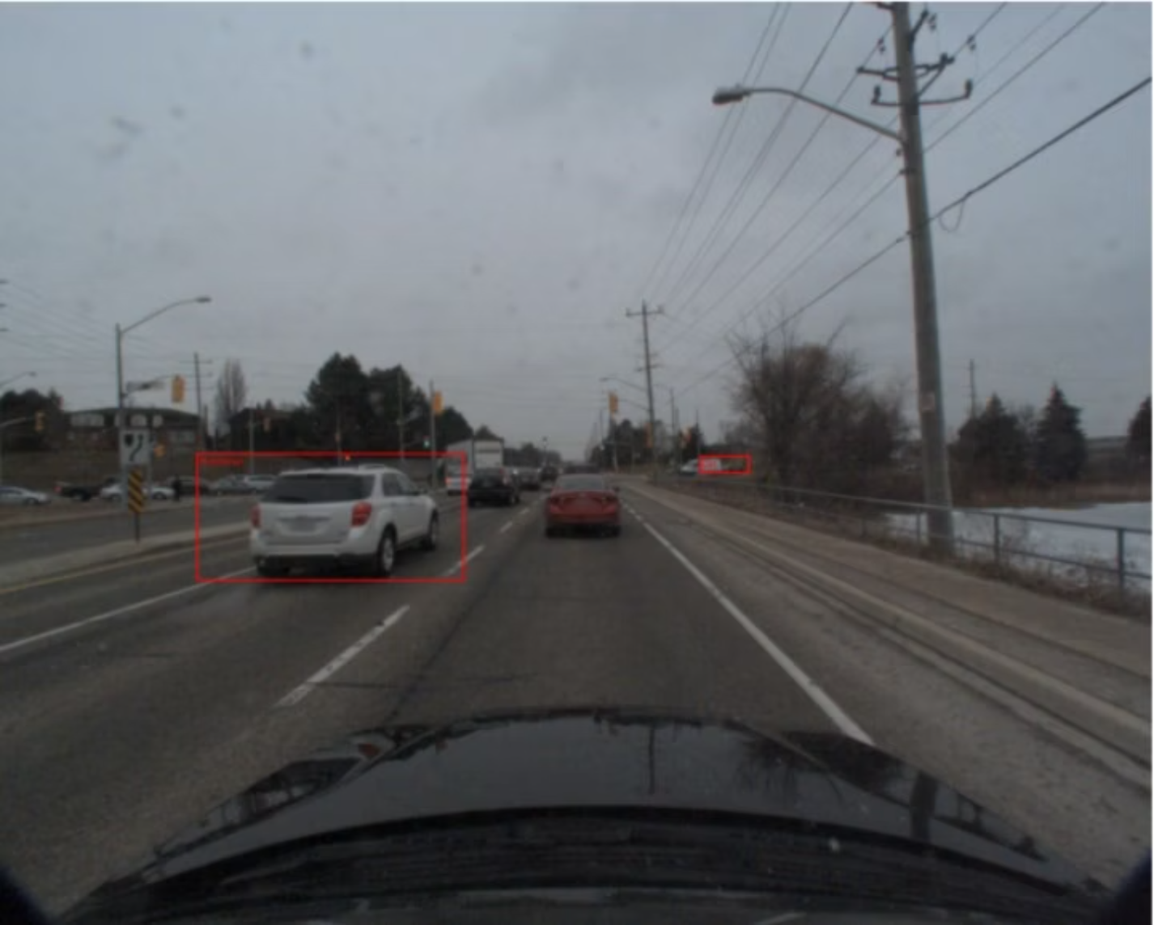
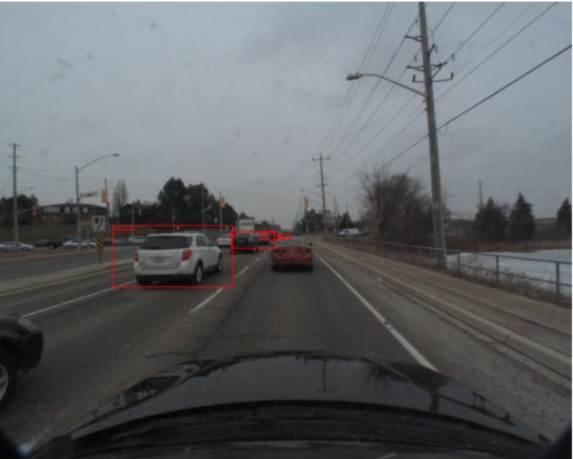
Visualizing Detection Results
The following visualizations showcase our model's 3D object detection capabilities across challenging Canadian adverse driving conditions from the CADC dataset, demonstrating robust performance in real-world scenarios.
These side-by-side comparisons illustrate the detetion accuracy and reliability of both architectures under varying environmental conditions including snow, fog, and low-light scenarios.
Faster R-CNN Results
SSD Results

Slide 11
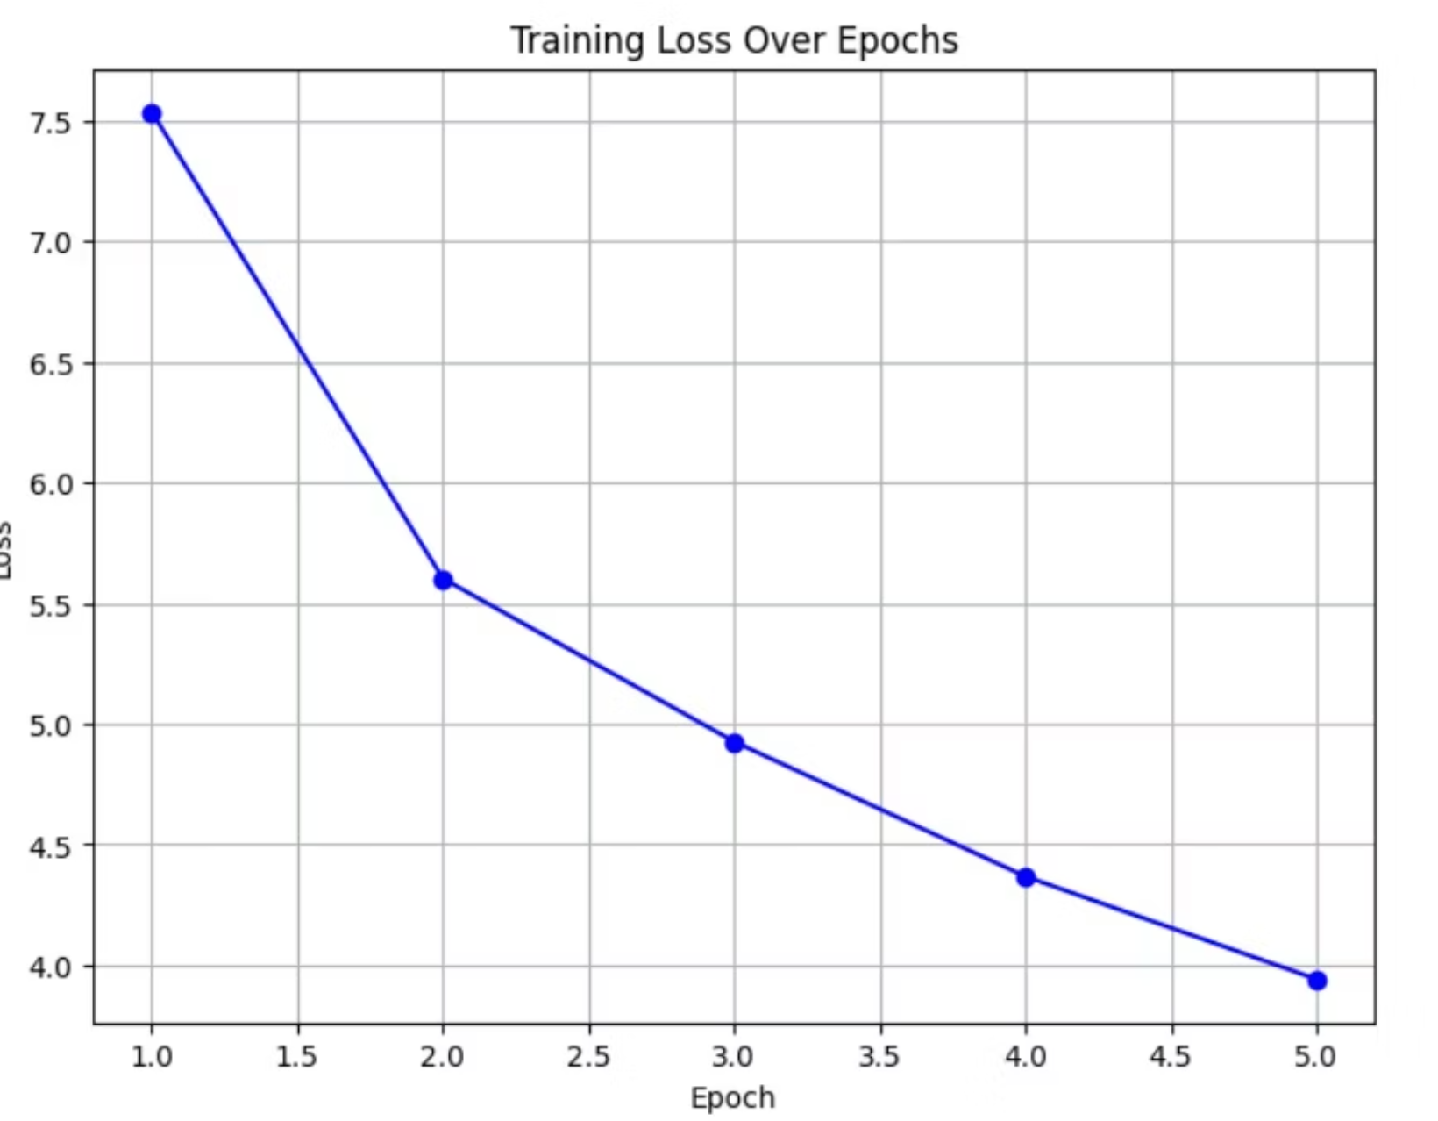
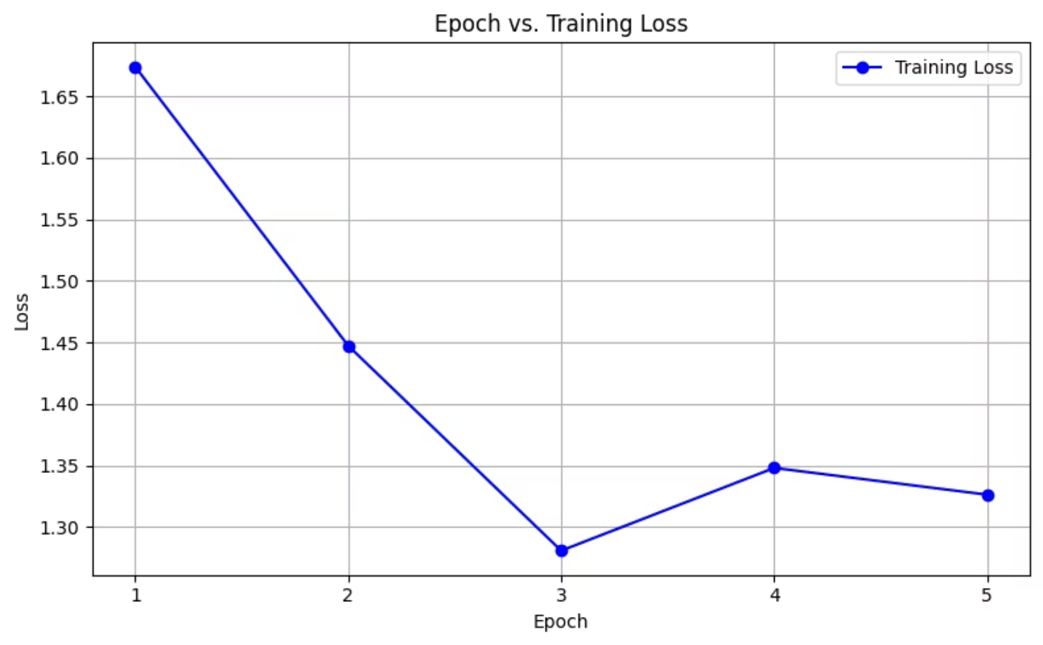
Single‑Shot Detector (SSD)
Faster R-CNN

Slide 12
Faster R-CNN vs SSD – Architectural Differences
Feature
Faster R-CNN
SSD (Single Shot Detector)
Pipeline Type
Two-stage (Region Proposal → Classification)
One-stage (Direct class + box prediction)
Region Proposal
Uses RPN (Region Proposal Network)
No RPN; anchors used at multiple feature maps
Speed
Slower (typically ~5–7 FPS)
Real-time capable (~20–50 FPS)
Accuracy
Higher accuracy, better for small objects
Slightly lower accuracy, struggles with small objects
Backbone
ResNet-50 + FPN
VGG + extra conv layers

Slide 13
Inference Differences on CADC Dataset
Aspect
Faster R-CNN
SSD
Object Detection
Precise bounding boxes (esp. for vehicles)
Faster detections, coarser box localization
Inference Time (T4 GPU)
~0.12 sec/frame (8–10 FPS)
~0.02–0.05 sec/frame (20–50 FPS)
Use-Case Suitability
Best for safety-critical or complex scenes
Best for lightweight, real-time applications

Slide 14
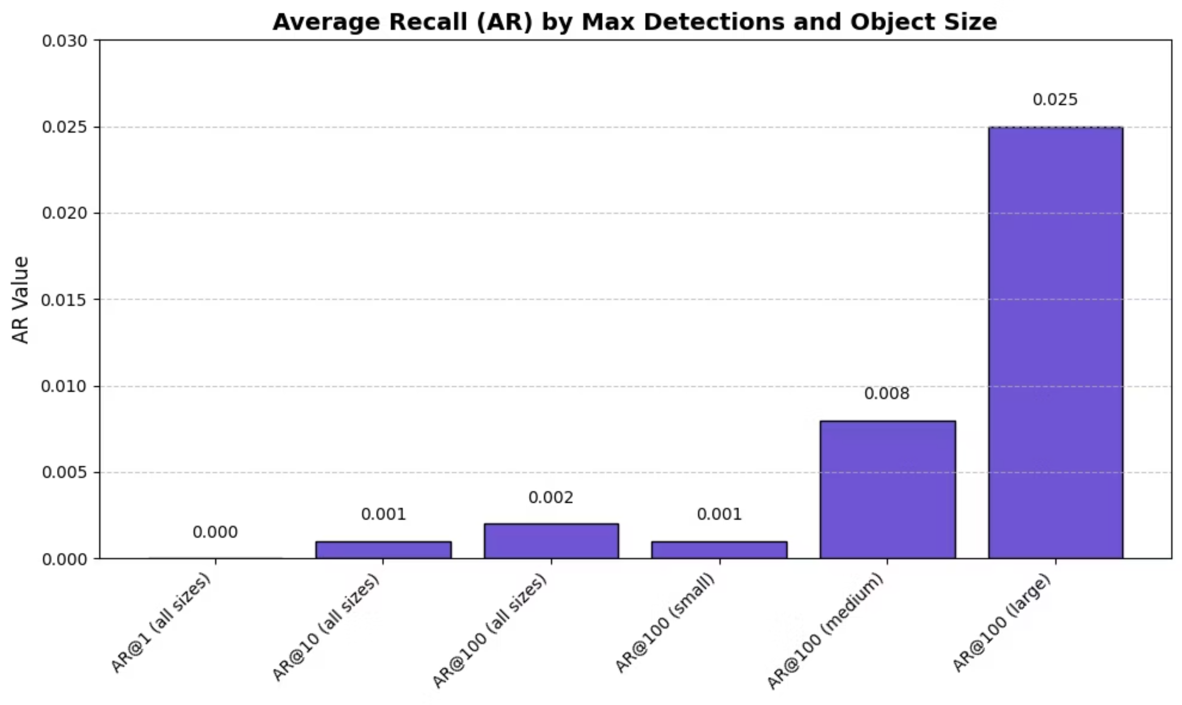
Average Recall (AR) by Max Detections & Object Size for SSD
Purpose: Reflects model’s ability to find relevant objects (regardless of confidence).Inference: Low recall even at 100 detections → model misses many objects. Slight improvement on large targets.

Slide 15
Technical Challenges & Solutions
3D to 2D Projection
Adverse Weather Impact
Class Imbalance
Complex coordinate transformations required careful handling of camera calibration matrices and coordinate system conventions between world, camera, and image spaces.
Reduced visibility and contrast in snow/fog conditions significantly impacted small object detection, requiring specialized augmentation strategies.
Uneven distribution of object classes in adverse conditions led to biased predictions, addressed through weighted sampling and focal loss implementation.

Slide 16
Future Work & Conclusions
1
Multi-Modal Integration
2
Real-Time Optimization
3
Enhanced Weather Adaptation
Incorporate LIDAR point clouds for improved 3D localization accuracy and robustness in adverse weather conditions.
Deploy optimized models using TensorRT for real-time inference in autonomous vehicle perception pipelines.
Develop weather-aware attention mechanisms and domain adaptation techniques for improved cross-condition generalization.
This work demonstrates the feasibility of training robust object detection models on adverse weather datasets, establishing baseline performance for future autonomous driving perception research.

Slide 17
Thank You
Questions & Discussion

